Slide 1
CVRA and Districting
City of Carpinteria

Slide 2
Overview
This presentation will cover a range of topics to facilitate a process of public education and involvement in a transparent and fair districting process.
The California Voting Rights Act
Districting vs. Redistricting vs. Gerrymandering
Traditional Districting/Redistricting Principles
Population and Composition
Mapping of the City of Carpinteria

Slide 3
What is the CVRA?
The California Voting Rights Act is a state law that prohibits the use of At-Large election systems in local government if there is racially polarized voting.
“At Large” is defined as anything other than a system in which an elected official lives in a district, and is only elected by members of that district.
“Racially Polarized Voting” is determined through an analysis which quantifies the amount of voting which can be shown to be correlated to race.

Slide 4
What is the CVRA?
The California Voting Rights Act takes the principles of the Federal Voting Rights Act and expands it regarding districted elections in two key ways:
While Federal law uses “majority minority” districts as a standard for vulnerability, the CVRA only requires “ability to influence.”
The CVRA requires that plaintiffs get full reimbursement for legal fees associated with any successful challenge.

Slide 5
What is the CVRA?
The California Voting Rights Act takes the principles of the Federal Voting Rights Act and expands it regarding districted elections in two key ways:
While Federal law uses “majority minority” districts as a standard for vulnerability, the CVRA only requires “ability to influence.”
The CVRA requires that plaintiffs get full reimbursement for legal fees associated with any successful challenge. These can be lessened or eliminated if the district follows a strict and prompt process for districting.

Slide 6
What is Districting
definition
Districting is the initial process of creating election district boundaries.
These boundaries determine:
Eligibility to run for office - must live within boundaries to qualify for election.
Who votes in the election – only voters within the district vote for their councilmember.

Slide 7
What is Districting
definition
Districting is the initial process of creating election district boundaries.
These boundaries do not determine:
How the city decides to govern. The city can still work to achieve goals that benefit the city as a whole rather than the interests of any single district.
How services or relationships between the city and the public are managed.

Slide 8
What is Redistricting
definition
Redistricting is the process of adjusting district lines every 10 years after the release of the US Census. The best known examples are Congress and the legislature.
Within the US, redistricting has become an extremely politicized process and been the subject of more high-profile Supreme Court decisions than any other part of our elections system.

Slide 9
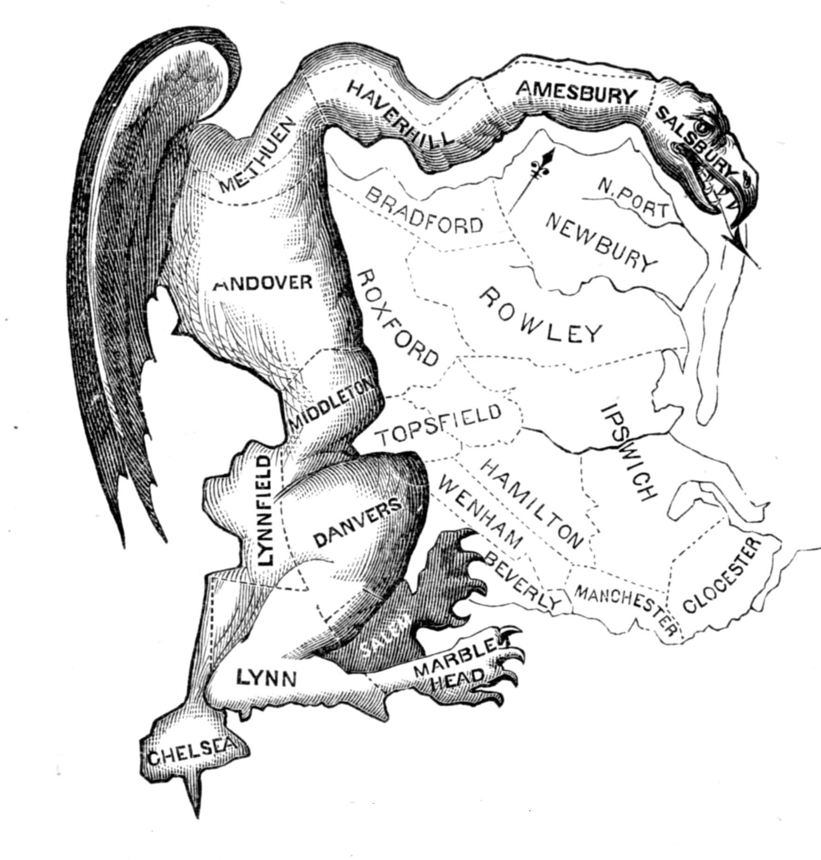
What is Gerrymandering
The Gerrymander
The term Gerrymander came
from a cartoon depicting a
rather serpentine looking district created by Governor Elbridge Gerry in Massachusetts.

Slide 10
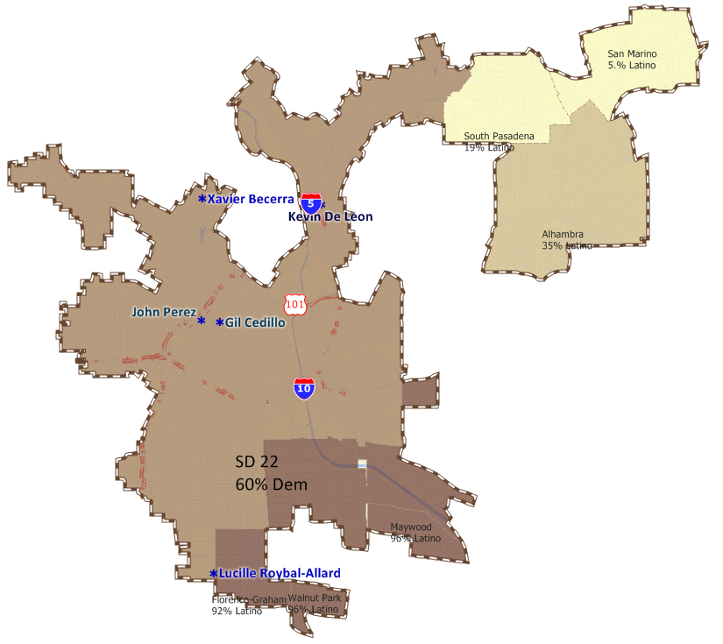
What is Gerrymandering
the Gerrymander
There are more recent
examples of gerrymandering,
even in California.
This 2001 Senate District is
a great example.

Slide 11
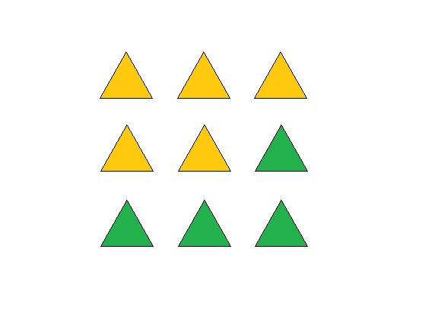
What is Gerrymandering
How does gerrymandering work?

Slide 12
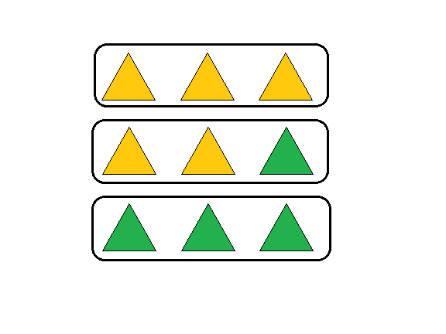
What is Gerrymandering
How does gerrymandering work?

Slide 13
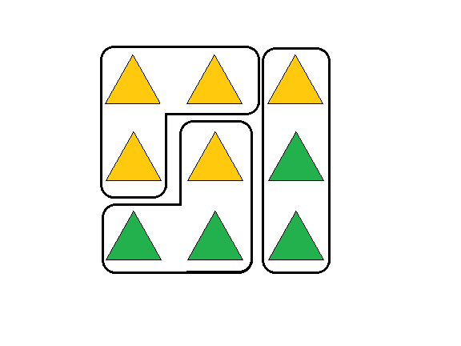
What is Gerrymandering
How does gerrymandering work?

Slide 14
What is Gerrymandering
Types of Gerrymanders
The two primary types of gerrymanders are Partisan and Racial, but there are more.
Partisan Gerrymandering – current Supreme Court has determined these non-justiciable but some state and local laws have stepped in to ban them.
Racial Gerrymandering – courts have repeatedly found these to be unlawful.
Incumbent Gerrymandering – common in any redistricting conducted by the agency itself.

Slide 15
Traditional Redistricting Principles
Preventing a Districting from becoming a Gerrymander
There are a number of criteria that have been used nationally and upheld by courts.
Relatively equal size - people, not citizens
Contiguous – districts should not hop/jump
Maintain “communities of interest”
Follow city/county/local government lines
Keep districts compact – appearance/function

Slide 16
Traditional Redistricting Principles
Preventing a Districting from becoming a Gerrymander
There are a number of criteria that have been used nationally and upheld by courts.
Relatively equal size - people, not citizens
Contiguous – districts should not hop/jump
Maintain “communities of interest”
Follow city/county/local government lines
Keep districts compact – appearance/function

Slide 17
Traditional Redistricting Principles
Preventing a Districting from becoming a Gerrymander
There are a number of criteria that have been used nationally and upheld by courts.
Relatively equal size - people, not citizens
Contiguous – districts should not hop/jump
Maintain “communities of interest”
Follow city/county/local government lines
Keep districts compact – appearance/function

Slide 18
Traditional Redistricting Principles
Preventing a Districting from becoming a Gerrymander
There are a number of criteria that have been used nationally and upheld by courts.
Relatively equal size - people, not citizens
Contiguous – districts should not hop/jump
Maintain “communities of interest”
Follow city/county/local government lines
Keep districts compact – appearance/function

Slide 19
Communities of Interest
Bringing like people together for representation
A community of interest includes ethnic and language minorities and other groups as discussed.
Many more, including:
LGBTQ+ Communities
Senior Citizens or Students
Downtown / Urban
Rural or Agricultural
Homeowners or Renters
Notes:
While race is a community of interest, it cannot be the predominant factor in drawing districts.
Why did we take this sentence out?

Slide 20
Communities of Interest
Bringing like people together for representation
What are you looking for in trying to judge the applicability of a Community of Interest to the redistricting process?
Group with shared culture / characteristics
Geographic Nature / Density / Ability to be mapped
Relationship to Agency / Policies

Slide 21
Communities of Interest
Bringing like people together for representation
What is a community of interest? It includes ethnic and language minorities and other groups.
Communities covered by the Voting Rights Act
Latinos
Asians
African Americans
While race is a community of interest, it cannot be the predominant factor in drawing districts.

Slide 22
Communities of Interest
Bringing like people together for representation
What is a community of interest? It includes ethnic and language minorities and other groups.
Other Communities, example are:
People living near an industry (farming, higher education, manufacturing)
Senior Citizens or Students
Downtown / Urban
Rural or Agricultural
Homeowners or Renters

Slide 23
Traditional Redistricting Principles
Preventing a Districting from becoming a Gerrymander
There are a number of criteria that have been used nationally and upheld by courts.
Relatively equal size - people, not citizens
Contiguous – districts should not hop/jump
Maintain “communities of interest”
Follow city/county/local government lines
Keep districts compact – appearance/function

Slide 24
Protecting Neighborhoods
Bringing like people together for representation
FAIR MAPS Act:
To the extent practicable, the geographic integrity of any local neighborhood or local community of interest shall be respected in a manner that minimizes its division.

Slide 25
Traditional Redistricting Principles
Preventing a Districting from becoming a Gerrymander
There are a number of criteria that have been used nationally and upheld by courts.
Relatively equal size - people, not citizens
Contiguous – districts should not hop/jump
Maintain “communities of interest”
Follow city/county/local government lines
Keep districts compact – appearance/function

Slide 26
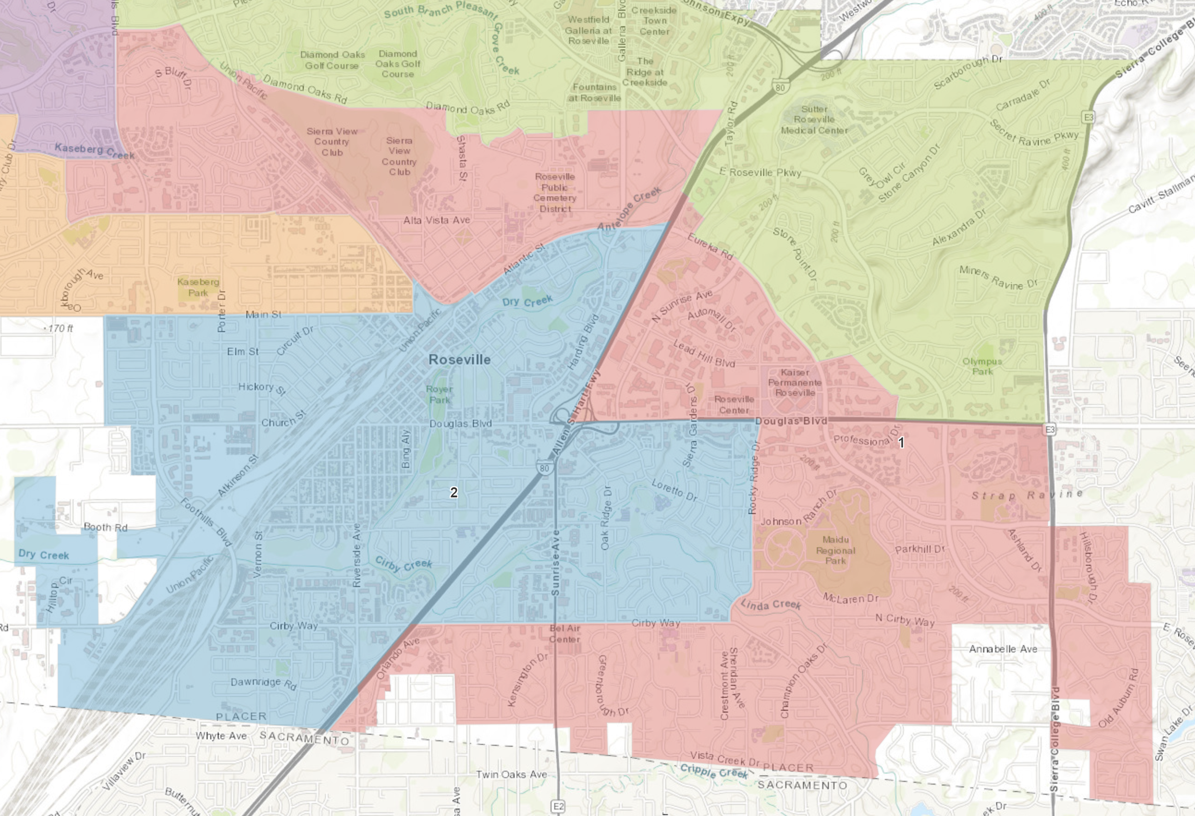
Compactness
Determining what is “compact”
California has a rather elegant/simple definition.
Not bypassing nearby populated areas in favor of more distant populated areas
Notes:
Get rid of Martinez and talk about Roseville

Slide 27
Traditional Redistricting Principles
Preventing a Districting from becoming a Gerrymander
New Criteria for 2020 under the Fair Maps Act:
Count prisoner population at their residence prior to incarceration.
Defines “communities of interest” as not including relationships with political parties, incumbents, or political candidates.
Prohibits districts from being drawn for the purpose of favoring or discriminating against a political party.
Prohibits mid-decade redistricting.

Slide 28
Additional Redistricting Rules
Criteria required in San Jose beyond Traditional Principles
The FAIR MAPS Act adds more criteria to the process.
Hold minimum set of hearings, encourage public engagement.
Posting of all redistricting commission information on a website that is maintained for the next 10 years.
Notes:
Add FMA requires public outreach.
Make about process
Interact with CBOs
Maps discussed in 7 days prior

Slide 29
City of Carpinteria
Preliminary Findings
Estimated population according to the American Community Survey is 13,376
We can’t use the estimated population for the districting process, but we can use it for planning purposes.
Using this estimated population to determine an estimated target size of a council district the ideal population is: 2,675
Under the “equal population” criteria the total district population deviation (from smallest to largest) cannot exceed 10%.

Slide 30
City of Carpinteria
Preliminary Findings
For determining ethnicity of a district we use the American Community Survey calculations of Citizen Voting Age Population or “CVAP” which is also sometimes called “eligible voters population”:
CVAP: 8,871
Asian CVAP: 167
Latino CVAP: 2,642
Black CVAP: 24
White CVAP: 6,020

Slide 31
City Boundaries and Streets

Slide 32
Latino CVAP

Slide 33
Asian CVAP

Slide 34
City of Carpinteria
What’s Next
Public hearings will be held to obtain input on communities of interest and receive feedback on potential districting plans prior to board adoption
Input can be provided in public hearings or using our Community of Interest Worksheet.

Slide 35
City of Carpinteria
What’s Next
Public hearings will be held to obtain input on communities of interest and receive feedback
___________ 1st Public Hearing
___________ 2nd Public Hearing
(Wait for Census Release Summer / Fall of 2021)
7 Days before 3rd Hearing Initial draft maps published
October 2021 1st Map Hearing
7 Days before 4th Hearing Publish amended draft maps (if any)
January 2022 2nd Map Hearing
7 Days before adoption Publish final map
February 2022 Adoption

